Slide 1
Tagged Figures for The Induction of Pyrenoid Synthesis by Hydrogen Peroxide and its Implications for the Natural Diversity of Tolerance to Hyperoxia in Chlamydomonas
This contains all figures with microscopy: Main text, Supplementary Material, and Transparent Reporting Images. Images will also be submitted in a series of folders, determined by figure number, and subfolders.
Peter Neofotis, Joshua Temple, Oliver L. Tessmer, Jacob Bibik, Nicole Norris, Eric Poliner, Ben Lucker, Sarathi M. Weraduwage, Alecia Withrow, Barbara Sears, Greg Mogos, Melinda Frame, David Hall, Joe Weissman, and David Kramer
Please Note: The corresponding figure number is noted on each slide, but so that the actual images can be seen the full figure caption has been abbreviated.

Slide 2
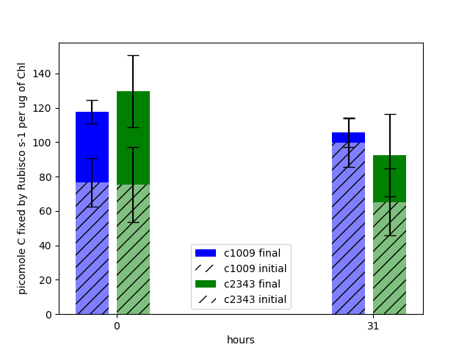
A
HighOxygen&PTOX/FirstDecayValues12_Submission.xlsx
The Rubisco Figures were made in this notebook
Notebook titled “RubiscoAnalysis_April27”
B
 | 0 Hours |  |  |  |  | 31 Hours
 | Initial | STD (+/-) | Final | STD (+/-) | % Activity | Initial | STD (+/-) | Final | STD (+/-) | % Activity
CC-1009 | 77 | 14 | 118 | 6.9 | 65 | 100 | 14 | 106 | 8.4 | 94
CC-2343 | 75 | 22 | 130 | 21 | 58 | 65 | 19 | 92 | 24 | 71
P-Values | 0.91 |  | 0.32 |  |  | 0.068 |  | 0.42

Slide 3
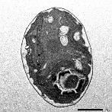
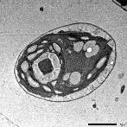
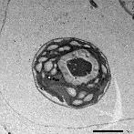
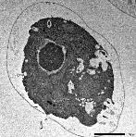
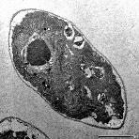
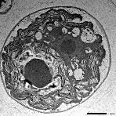
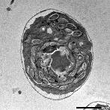
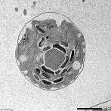
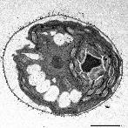
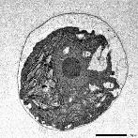
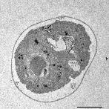
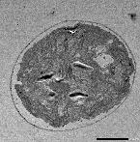
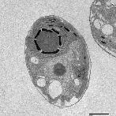
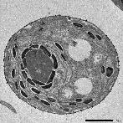
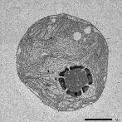
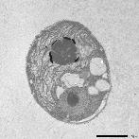
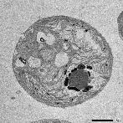
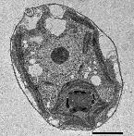
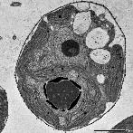
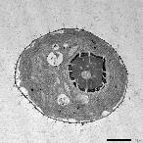
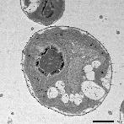
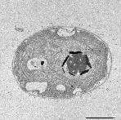
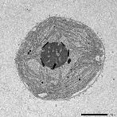
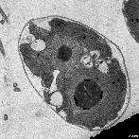
CC-1009
c1_1
c1_2
c1_3
c1_4
CC-2343
CC_1009 6 hours_#0.jpg
MP1_2 6 hours_#0.jpg
CC_2343 6 hours_#0.jpg
MP1_1 6 hours_#0.jpg
P
P
Hyperoxia (6 h)
P
P
MP1_3 6 hours_#0.jpg
MP1_4 6 hours_#0.jpg
P
P
CC 1009 hour 31_#0.jpg
MP1_2 hour 31_#0.jpg
MP1_3 hour 31_#0.jpg
CC 2343 hour 31_#0.jpg
MP1_1 hour 31_#0.jpg
MP1_4 hour 31_#0.jpg
Hyperoxia (36 h)
P
P
P
P
Figure 2
P
P
MP1.1 control T0_#0.jpg
MP1.3 control T0_#0.jpg
MP1.4 control T0_#0.jpg
CC-1009 control 0T_#0.jpg
MP1.3 control T0_#0.jpg
CC-2343 control 0T_#0.jpg
P
P
High Light
P
P
P
P
CC-1009 low CO2-T6_#0.jpg
MP 1.1 low CO2 T6_#0.jpg
MP 1.3 low CO2 T6_#0.jpg
CC-2343 low CO2 T6_#0.jpg
MP 1.2 low CO2 T6_#0.jpg
MP 1.4 low CO2 T6_#0.jpg
Low CO₂ (6h)
P
P
P
P
P
P
A
B

Slide 4
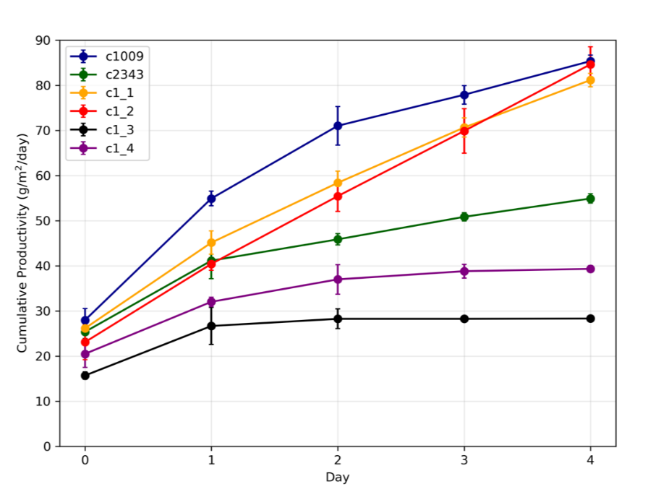
Josh May1 (1).ipynb
sealed sheath
productivity_python (1).xlsx
Figure 3
fragmented sheath

Slide 5
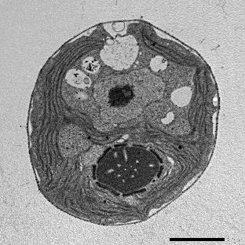
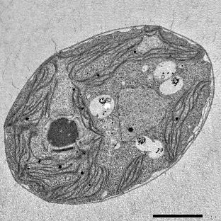
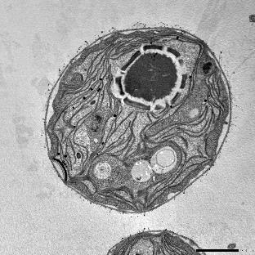
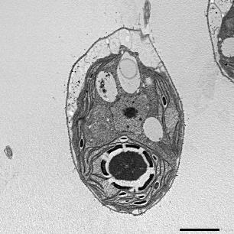
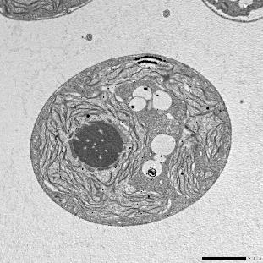
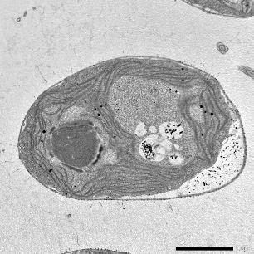
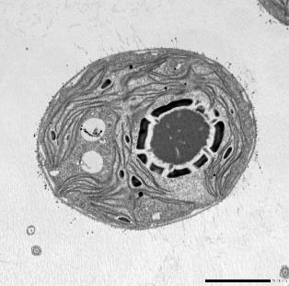
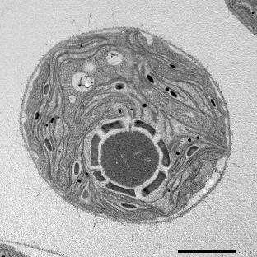
CC-1009
1009 Control_h2o2exp_006.jpg
1009 Control_h2o2exp_024.jpg
1009 peroxide_028.jpg
1009 peroxide_021.jpg
Figure 4: (H₂O₂ effects)
1009 peroxide_018.jpg
1009 peroxide_017.jpg
1009 Control_h2o2exp_019.jpg
1009 Control_h2o2exp_008.jpg
CONTROL
H₂O₂ Treatment
A
B

Slide 6
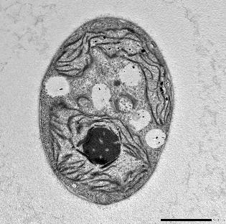
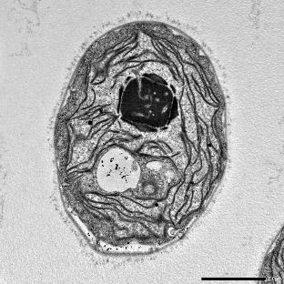
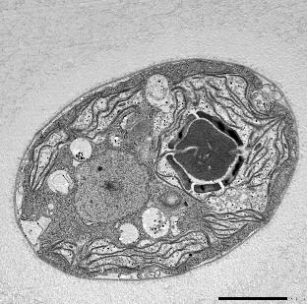
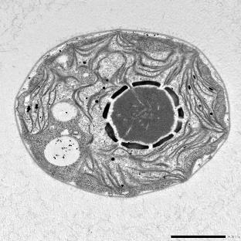
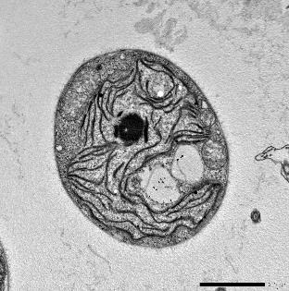
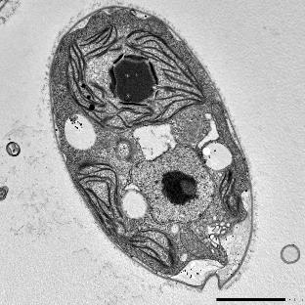
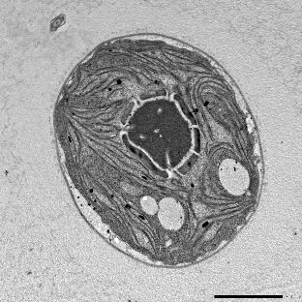
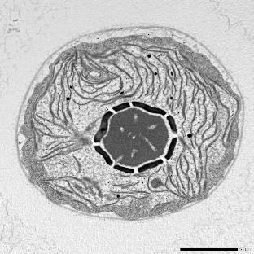
CC-2343
2343 Control_h2o2exp_001.jpg
2343 peroxide_005.jpg
2343 Control_h2o2exp_005.jpg
2343 peroxide_021.jpg
Figure 4: (H₂O₂ effects)
2343 Control_h2o2exp_011.jpg
2343 Control_h2o2exp_031.jpg
2343 peroxide_008.jpg
2343 peroxide_025.jpg
Control
H₂O₂ Treatment
C
D

Slide 7
Peter Aug27-2021.ipynb
PyrenoidImageJAnalysis4.xlsx

Slide 8
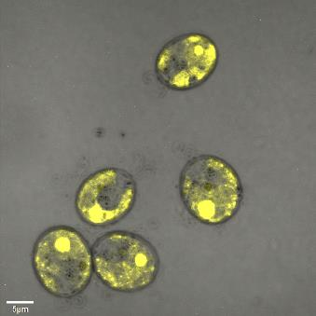
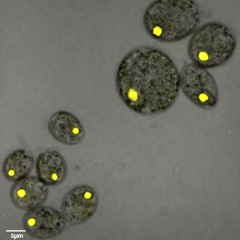
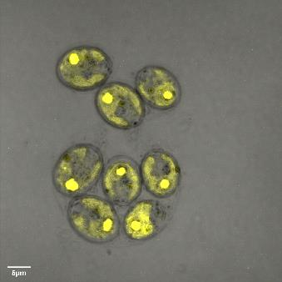
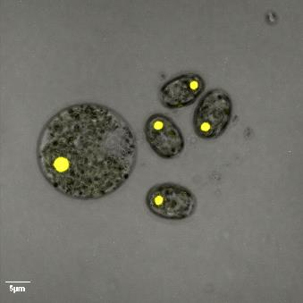
A
B
A
C
5357-Plus-1-MIP-Yellow-BF.tif
5357-Minus-3-MIP-Yellow-BF.tif
Is the Python notebook that was used to generate this graph
PyrenoidFlourescenceMicroscropy.ipynb
CC-5357
5357-Plus-2-MIP-Yellow-BF.tif
Control
H₂O₂ Treated
5357-Minus-2-MIP-Yellow-BF.tif
Figure 6
Control
H₂O₂ treated

Slide 9
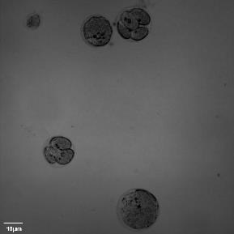
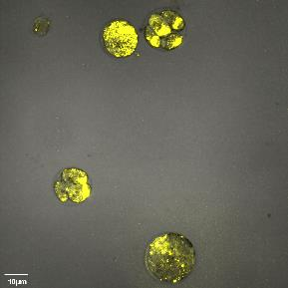
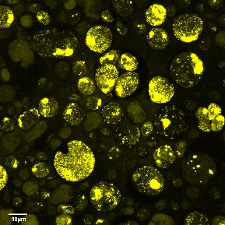
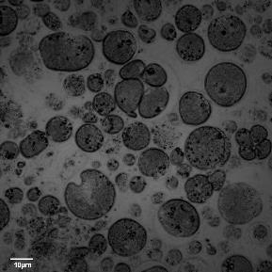

5357-TAP Plate Grown-1-MIP-Yellow.tif
5357-TAP Plate Grown-1-MIP-BF.tif
5357-TAP Plate Grown-1-MIP-Yellow-BF.tif
CC-5357
A
5357-TAP Plate Grown-4-MIP-Yellow.tif
5357-TAP Plate Grown-4-MIP-BF.tif
5357-TAP Plate Grown-4-MIP-Yellow-BF.tif
Venus
Bright field
Venus merged with bright field
Figure 7: (Panel A, Top) Confocal microscopy of CC-5357, which has a Venus labeled RBCS1, after being grown overnight on a TAP plate, showing that rubisco has dissociated from the pyrenoid. Scale bar = 5 μm.

Slide 10




Minus-INTAP-100xobjective-1xzoom-4-MIP-Yellow.tif
Minus-INTAP-100xobjective-1xzoom-4-MIP-BF.tif
Minus-INTAP-100xobjective-1xzoom-4-MIP-Yellow-BF.tif
CC-5357
Minus-INTAP-100xobjective-1xzoom-5-MIP-Yellow.tif
Minus-INTAP-100xobjective-1xzoom-5-MIP-BF.tif
Minus-INTAP-100xobjective-1xzoom-5-MIP-Yellow-BF.tif
B
Venus
Bright field
Venus merged with bright field
Figure 7: (Panel B, bottom) Confocal microscopy of CC-5357, which has a Venus labeled RBCS1, after being grown in liquid TAP, showing that rubisco has de-localized to some extent, but remains largely localized. Scale bar = 5 μm.

Slide 11
Figure 8
April14_AmplexRedAnalysis.ipynb

Slide 12


ROS
ROS/Chl
ROS
ROS/Chl
1009 Steady State-2_C001.tif
1009 Steady State-2_Green-Red.tif
2343-20uM-Steady State-3_C001.tif
2343-20uM-Steady State-3-Green-Red.tif
1009 Steady State-2.tif.frames
(see folder)
BF
Chl
BF
Chl
Figure 9: ROS in cells growing at steady state (Panels A & B)
1009 Steady State-2_C003.tif
1009 Steady State-2_C002.tif
2343-20uM-Steady State-3_C003.tif
2343-20uM-Steady State-3_C002.tif
CC-2343
CC-1009
A
B

Slide 13


ROS
ROS/Chl
ROS
ROS/Chl
C2343-31Hr.tif.frames
C1009-31Hr.tif.frames
C2343-31Hr-0_5ul-4_C001.tif
C2343-31Hr-0_5ul-4-Green-Red.tif
C1009-31Hr-5ul-2_C001.tif
C1009-31Hr-5ul-2-Green Red.tif
BF
Chl
BF
Chl
Figure 9: ROS in cells following exposure to 31 hours of hyperoxia (Panels C & D) of CC-2343 and CC-1009
C2343-31Hr-0_5ul-4_C003.tif
C2343-31Hr-0_5ul-4_C002.tif
C1009-31Hr-5ul-2_C003.tif
C1009-31Hr-5ul-2_C002.tif
CC-2343
CC-1009
C
D

Slide 14
A: CC-2343
B: CC-1009
μM O₂
μM O₂
H₂O₂ treated
H₂O₂ treated
Control
Control

Slide 15







c1009.tif
c1010.tif
c1373.tif
c1690.tif
c2290.tif
c2343.tif
c2344.tif
CC-1009
CC-1010
CC-1373
CC-1690
CC-2290
CC-2343
CC-2344
Supplementary Material Figure 1: Exemplary pictures of ecotypes which were examined in this study showing various pyrenoid formations, with CC-1009 and CC-1010 exhibiting “closed” types. Cultures were grown within flasks in minimal (2NBH) media under 50 μmoles m⁻² s⁻¹ of PAR.

Slide 16



Supplementary Material Figure 2. Panel A) Photo of five days after 50ml of fresh 2NBH media was inoculated to 1x10⁵ cells/ml, and cultures were continuously bubbled with 5% CO₂ and 95% O₂. Panel B) Graph of cell counts and chlorophyll content.
A
B
1009
2343

Slide 17








c1009_HighCO2_2.tif
c2343_HighCO2_1.tif
c1009_HighCO2_1.tif
c2343_HighCO2_2.tif
Supplementary Material Figure 3: Exemplary light microscopy images of Chlamydomonas strains (CC-1009 & CC-2343), while growing under saturating CO₂.
c2343_HighCO2_4.tif
c1009_HighCO2_3.tif
c2343_HighCO2_3.tif
A
c1009_HighCO2_4.tif
B
1009
2343

Slide 18








c1009_HyperO_6Hours_1.tif
c1009_HyperO_6Hours_2.tif
c2343_HyperO_6Hours_1.tif
c2343_HyperO_6Hours_2.tif
Supplementary Material Figure 4: Exemplary light microscopy images of Chlamydomonas strains (CC-1009 & CC-2343), after growing under saturating CO₂ and hyperoxia for 6 hours. Pyrenoid starch sheaths were clearly visible.
c2343_HyperO_6Hours_4.tif
c2343_HyperO_6Hours_3.tif
c1009_HyperO_6Hours_3.tif
c1009_HyperO_6Hours_4.tif
A
B
1009
2343

Slide 19









c1009_HyperO_31Hours_1.tif
c2343_HyperO_31Hours1.tif
c2343_HyperO_31Hours2.tif
c1009_HyperO_31Hours_2.tif
Supplementary Material Figure 5: Exemplary light microscopy images of Chlamydomonas strains (CC-1009 & CC-2343), after growing under saturating CO₂ and hyperoxia for 31 hours.
c1009_HyperO_31Hours_4.tif
c2343_HyperO_31Hours4.tif
c1009_HyperO_31Hours_5.tif
c2343_HyperO_31Hours3.tif
c1009_HyperO_31Hours_3.tif
A
B
1009
2343

Slide 20
SM Figure 6
TestPyrenoidIntegrity6.csv
PyrenoidShapeGraph4.R

Slide 21

SM Figure 7
A
B
CC-1009
CC-2343
c1_1
c1_2
c1_3
c1_4

Slide 22
Supplementary Material Figure 8: Φ_{II} values of spotted plates of parents and tetrad after one week, with c1_3, and c1_4 not showing any obvious higher level of electron transport, despite higher growth rates. Measurements shown here were under 50 μM of PAR, though similar results were obtained up to 1500 μmoles m⁻² s⁻².

Slide 23
SM Figure 9
starch_figures_April29.ipynb
PBRexp040_StarchSampleInfo_jupyter.xlsx

Slide 24






CC 1009 0 hours_#0.jpg
CC 2343 0 hours_#0.jpg
CC-1009
CC-2343
P
SM Figure 10: (Early morning)
MP1_1 0 hours_#0.jpg
MP1_2 0 hours_#0.jpg
MP1_3 0 hours_#0.jpg
MP1_4 0 hours #0.jpg
P
P
P
c1_1
c1_2
c1_3
c1_4
A
B

Slide 25






Supplementary Material Figure 11: 31 Hours Low CO₂
CC-1009 low CO2 T 31_#0.jpg
CC-2343 low CO2 T 31_#0.jpg
CC-1009
CC-2343
P
P
MP 1.1 low CO2 T 31_#0.jpg
MP 1.2 low CO2 T 31_#0.jpg
MP 1.3 low CO2 T 31_#0.jpg
MP 1.4 low CO2 T 31_#0.jpg
P
P
P
P
P
P
c1_1
c1_2
c1_3
c1_4
A
B

Slide 26

Control_2.tif
MV_1.tif
MV_2.tif
Control_1.tif
Supplementary Material Figure 13: Representative light microscopy images of CC-2343 control (Panel A) and treated (Panel B) cells, two hours after our sinusoidal light had turned on, with .1μM of methyl viologen.
Control_3.tif
Control_4.tif
MV_3.tif
MV_4.tif
A
B
CONTROL
Methyl Viologen

Slide 27



Metro_1.tif
Metro_2.tif
Control_1.tif
Control_2.tif
Supplementary Material Figure 14: Representative light microscopy images of CC-2343 control (Panel A) and treated (Panel B) cells, two hours after our sinusoidal light had turned on, with 4mM of metronidazole.
Control_3.tif
Metro_4.tif
Metro_3.tif
Control_4.tif
A
B
CONTROL
Metronidazole

Slide 28







AscorbateExpControl_1.tif
AscorbateExpControl_2.tif
Ascorbate1.tif
Ascorbate2.tif
Supplementary Material Figure 15: Representative light microscopy images of CC-1009 control (Panel A) and 10mM ascorbate treated (Panel B) cells, grown for 24 hours while being bubbled with air (low CO₂) in minimal 2NBH media under ~85 μmoles photons m⁻² s⁻¹ .
Ascorbate3.tif
AscorbateExpControl_4.tif
AscorbateExpControl_3.tif
A
B
CONTROL
ASCORBATE

Slide 29





DimethylControl_1.tif
DimethylControl_2.tif
Dimethylthiourea_1.tif
Dimethylthiourea_2.tif
Supplementary Material Figure 16: Representative light microscopy images of CC-1009 control (Panel A) and 15mM dimethylthiourea treated (Panel B) cells.
Dimethylthiourea_3.tif
Dimethylthiourea_4.tif
DimethylControl_3.tif
DimethylControl_4.tif
CONTROL
DIMETHYLTHIOUREA

Slide 30


Supplementary Material Figure 17: Localization of rubisco, control cells (Panel A) and cells exposed to 100μM H₂O₂, visualized by the Nikon A1 Confocal Laser Scanning Confocal Microscope confocal microscopy, in strain CC-5357, containing at RBCS1-Venus. Scale bar = 2 μm.
Nikon_Control_1_overlay.tif
Nikon_Peroxide1_overlay.tif
Nikon_Control_2_overlay.tif
Nikon_Peroxide2_overlay.tif
A
B
Control
H₂O₂ Treated

Slide 31



A
B
C
5357-7_5mMBicarbonate- no MV-1-MIP_A001.tif
5357-7_5mMBicarbonate-MD-1-MIP_A001.tif
5357-7_5mMBicarbonate-MV-1-MIP_A001.tif
Supplementary Material Figure 18: Localization of rubisco, control cells (Panel A) and cells exposed to 0.1μM methyl viologen (Panel B) and 8 mM metronidazole (Panel C) visualized by an Olympus FluoView 1000 Confocal Laser Scanning Microscope, in strain CC-5357, containing at RBCS1-Venus. Scale bar = 10 μm.

Slide 32
Chl
Venus-Rubisco
Chl & Venus-Rubisco
SM Figure 19
High CO2-5357-60x-second batch-lower settings-1-MIP-R_RGB.tif
High CO2-5357-60x-second batch-lower settings-1-MIP-Y_RGB.tif
High CO2-5357-60x-second batch-lower settings-1-MIP-YR_RGB.tif
High CO₂
Chl
Venus-Rubisco
Chl & Venus-Rubisco
High CO2-5357-60x-second batch-lower settings-2-R_RGB.tif
High CO2-5357-60x-second batch-lower settings-2-Y_RGB.tif
High CO2-5357-60x-second batch-lower settings-2-YR_RGB.tif
A

Slide 33
Chl
Venus-Rubisco
Chl & Venus-Rubisco
SM Figure 19
Hyperoxia-CC5357-60x-second batch-lower settings-2-R_RGB.tif
Hyperoxia-CC5357-60x-second batch-lower settings-2-Y_RGB.tif
Hyperoxia-CC5357-60x-second batch-lower settings-2-YR_RGB.tif
High CO₂ and Hyeroxia
Chl
Venus-Rubisco
Chl & Venus-Rubisco
Hyperoxia-CC5357-60x-second batch-lower settings-3-R_RGB.tif
Hyperoxia-CC5357-60x-second batch-lower settings-3-Y_RGB.tif
Hyperoxia-CC5357-60x-second batch-lower settings-3-YR_RGB.tif
B

Slide 34
Chl
Venus-Rubisco
Chl & Venus-Rubisco
SM Figure 19
Low CO₂
Low CO2-5357-60x-second batch-lower settings-2-R_RGB.tif
Low CO2-5357-60x-second batch-lower settings-2-Y_RGB.tif
Low CO2-5357-60x-second batch-lower settings-2-YR_RGB.tif
Chl
Venus-Rubisco
Chl & Venus-Rubisco
C
Low CO2-5357-60x-second batch-lower settings-3-R_RGB.tif
Low CO2-5357-60x-second batch-lower settings-3-Y_RGB.tif
Low CO2-5357-60x-second batch-lower settings-3-YR_RGB.tif

Slide 35
SM Figure 19
RubiscoContent_Submit.csv
RubiscoContent_Graph.R

Slide 36


SM Figure 20
Minus-INTAP+Bicarbonate-100xobjective-1xzoom-4-MIP-Yellow-BF.tif
Plus-INTAP+Bicarbonate-100xobjective-1xzoom-4-MIP-Yellow-BF.tif
A
B
Control
H₂O₂ treated

Slide 37




5% CO₂ in Bioreactors at Steady State
c2343_SteadyState1.tif
c2343_SteadyState2
c2343_SteadyState3.tif
CC-2343
c2343_TapAgarGrown1.tif
c2343_TapAgarGrown2.tif
c2343_TapAgarGrown3.tif
TAP Plate
A
Supplementary Material Figure 21: Comparison of cells grown under steady state in liquid media (with 5% CO₂) versus cells grown on the surface of a TAP plate. Both CC-2343 (Panel A) and CC-1009 (Panel B) showed losses of the starch sheath when grown on a TAP plate.

Slide 38



5% CO₂ in Bioreactors at Steady State
c1009_SteadyState1.tif
c1009_SteadyState2.tif
c1009_SteadyState3.tif
CC-1009
c1009_TapAgarGrown1.tif
c1009_TapAgarGrown2.tif
c1009_TapAgarGrown3.tif
TAP Plate
B
Supplementary Material Figure 21: Comparison of cells grown under steady state in liquid media (with 5% CO₂) versus cells grown on the surface of a TAP plate. Both CC-2343 (Panel A) and CC-1009 (Panel B) showed losses of the starch sheath when grown on a TAP plate.

Slide 39
CC-1009
c1009_Control1.tif
c1009_Control2.tif
c1009_100uM_H2O2_1.tif
c1009_100uM_H2O2_2.tif
Supplementary Material Figure 23: Representative light microscopy images of CC-1009 (Panels A & B) and CC-2343 (Panels C & D) control and cells treated, two hours after our sinusoidal light had turned on, with 100 μM of H₂O_{2.}
c1009_Control3.tif
c1009_Control4.tif
c1009_100uM_H2O2_3.tif
c1009_100uM_H2O2_4.tif
A
B
CONTROL
H₂O₂ Treatment

Slide 40




CC-2343
c2343_Control1.tif
c2343_Control2.tif
Supplementary Material Figure 23: Representative light microscopy images of CC-1009 (Panels A & B) and CC-2343 (Panels B & C) control and cells treated, two hours after our sinusoidal light had turned on, with 100 μM of H₂O_{2.}
c2343_100uM_H2O2_1.tif
c2343_100uM_H2O2_2.tif
c2343_100uM_H2O2_3.tif
c2343_Control3.tif
c2343_Control4.tif
c2343_100uM_H2O2_4.tif
C
D
CONTROL
H₂O₂ Treatment

Slide 41

*
*
*
Supplementary Material Figure 22
barplot_data.csv
cia5
CC-5357
CC-5357 + 100 μM H₂O₂
CC-5357
Low Light, High CO₂
High Light, Low CO₂

Slide 42
CC-1009
c1009_DarkGrown_Control_1.tif
c1009_DarkGrown_Control_2.tif
c1009_DarkGrown_H2O2_1.tif
c1009_DarkGrown_H2O2_2.tif
Supplementary Material Figure 24: (H2O2 experiment in the dark)
c1009_DarkGrown_H2O2_4.tif
c1009_DarkGrown_Control_4.tif
c1009_DarkGrown_Control_3.tif
c1009_DarkGrown_H2O2_3.tif
A
B
CONTROL
H₂O₂ Treatment

Slide 43
CC-2343
c2343_DarkGrown_Control_1.tif
c2343_DarkGrown_Control_2.tif
c2343_H2O2_Dark_2.tif
c2343_H2O2_Dark_1.tif
Supplementary Material Figure 24: (H2O2 Experiment in the Dark)
c2343_DarkGrown_Control_3.tif
c2343_H2O2_Dark_4.tif
c2343_H2O2_Dark_3.tif
c2343_DarkGrown_Control_4.tif
C
D
CONTROL
H₂O₂ Treatment

Slide 44
Tagged Figures for The Induction of Pyrenoid Synthesis by Hydrogen Peroxide and its Implications for the Natural Diversity of Tolerance to Hyperoxia in Chlamydomonas
This contains all figures with microscopy: Main text, Supplementary Material, and Transparent Reporting Images. Images will also be submitted in a series of folders, determined by figure number, and subfolders.
Peter Neofotis, Joshua Temple, Oliver L. Tessmer, Jacob Bibik, Nicole Norris, Eric Poliner, Ben Lucker, Sarathi Wijetilleke, Alecia Withrow, Barbara Sears, Greg Mogos, Melinda Frame, David Hall, Joe Weissman, and David Kramer
Please Note: The corresponding figure number is noted on each slide, but so that the actual images can be seen the full figure caption has been abbreviated.

Slide 45
Transparent Reporting Form Images for

Slide 46
The Induction of Pyrenoid Synthesis by Hydrogen Peroxide and its Implications for the Natural Diversity of Tolerance to Hyperoxia in Chlamydomonas
Transparent Reporting Images for
Peter Neofotis, Joshua Temple, Oliver L. Tessmer, Jacob Bibik, Nicole Norris, Eric Poliner, Ben Lucker, Sarathi Wijetilleke, Alecia Withrow, Barbara Sears, Greg Mogos, Melinda Frame, David Hall, Joe Weissman, and David Kramer
Please Note: The corresponding figure number is noted on each slide, but so that the actual images can be seen the full figure caption has been abbreviated.

Slide 47
The following images are some additional images of the effects of hyperoxia on pyrenoid formation and our strains examined (Figure 2). These images were taken at 6 hours of hyperoxia. Like those in Figure 2, they show that that the pyrenoid is induced in our strains, but that there are genotypic dependent morphologies. CC-1009, c1_1, and c1_2 have large, sealed pyrenoids; and CC-2343, c1_3, and c1_4 having fractured, porous starch sheaths. Additional Figures are also given in Transparent Reporting Image Set 12.

Slide 48















CC_1009 6 hours_#1.jpg
CC_1009 6 hours_#2.jpg
CC_1009 6 hours_#3.jpg
c1009_6HO_#1.tif
c1009_6HO_#2.tif
c1009_6HO_#3.tif
c1009_6HO_#8.tif
c1009_6HO_#6.tif
CC_1009 6 hours_#4.jpg
CC_1009 6 hours_#5.jpg
CC_1009 6 hours_#6.jpg
c1009_6HO_#7.tif
c1009_6HO_#5.tif
c1009_6HO_#9.tif
Transparent Reporting Figure 1: Additional representative TEM images (left) and light microscopy (right) of Chlamydomonas strain (CC-1009) after being exposed to hyperoxia for six hours in the light. Cells show robust, continuous, sealed pyrenoids. Prior to switching the gas to hyperoxia (i.e. 95% O₂ and 5% CO₂) cells had been grown in steady state conditions, with 5% CO₂ with 14:10 hour (light:dark) sinusoidal illumination with peak light intensity of 2000 μmoles m⁻² s⁻¹, in minimal 2NBH media. TEM Scale bar = 2 μm (#1-3, #6) and 1 μm (#4, #5).
c1009_6HO_#4.tif
CC-1009: Continuous, sealed pyrenoids.

Slide 49
















c2343_6HO_#3.tif
c2343_6HO_#5.tif
C2343_6HO_#2.tif
c2343_6HO_#7.tif
c2343_6HO_#6.tif
c2343_6HO_#1.tif
CC_2343 6 hours_#1.jpg
CC_2343 6 hours_#2.jpg
CC_2343 6 hours_#3.jpg
c2343_6HO_#10.tif
c2343_6HO_#8.tif
c2343_6HO_#4.tif
CC_2343 6 hours_#5.jpg
CC_2343 6 hours_#6.jpg
c2343_6HO_#9.tif
Transparent Reporting Figure 2: Additional representative TEM images (left) and light microscopy (right) of Chlamydomonas strain (CC-2343) after being exposed to hyperoxia for six hours in the light. Cells show fractured pyrenoids. Prior to switching the gas to hyperoxia (i.e. 95% O₂ and 5% CO₂) cells had been grown in steady state conditions, with 5% CO₂ with 14:10 hour (light:dark) sinusoidal illumination with peak light intensity of 2000 μmoles m⁻² s⁻¹, in minimal 2NBH media. TEM Scale bar = 2 μm.
CC_2343 6 hours_#4.jpg
CC-2343: fractured, porous pyrenoids.

Slide 50















MP1_1 6hours_#1.jpg
MP1_1 6hours_#2.jpg
MP1_1 6hours_#3.jpg
c1_1_6HO_#3.tif
c1_1_6HO_#0.tif
c1_1_6HO_#4.tif
c1_1_6HO_#1.tif
c1_1_6HO_#6.tif
c1_1_6HO_#5.tif
MP1_1 6hours_#4.jpg
MP1_1 6hours_#5.jpg
MP1_1 6hours_#6.jpg
c1_1_6HO_#7.tif
c1_1_6HO_#2.tif
Transparent Reporting Figure 3: Additional representative TEM (left) and light microscopy (right) images of Chlamydomonas strains (c1_1) after being exposed to hyperoxia for six hours in the light. Cells show continuous, sealed pyrenoids. Prior to switching the gas to hyperoxia (i.e. 95% O₂ and 5% CO₂) cells had been grown in steady state conditions, with 5% CO₂ with 14:10 hour (light:dark) sinusoidal illumination with peak light intensity of 2000 μmoles m⁻² s⁻¹, in minimal 2NBH media. TEM Scale bar = 2 μm.
c1_1: Continuous, sealed pyrenoids.

Slide 51










c1_2_6HO_#6.tif
c1_2_6HO_#5.tif
MP1_2 6hours_#1.jpg
MP1_2 6hours_#2.jpg
MP1_2 6hours_#3.jpg
c1_2_6HO_#2.tif
c1_2_6HO_#3.tif
MP1_2 6hours_#4.jpg
MP1_2 6hours_#5.jpg
MP1_2 6hours_#6.jpg
Transparent Reporting Figure 4: Additional representative TEM (left) and light microscopy images of Chlamydomonas strains (c1_2) after being exposed to hyperoxia for six hours in the light. Cells show robust, continuous, sealed pyrenoids. Prior to switching the gas to hyperoxia (i.e. 95% O₂ and 5% CO₂) cells had been grown in steady state conditions, with 5% CO₂ with 14:10 hour (light:dark) sinusoidal illumination with peak light intensity of 2000 μmoles m⁻² s⁻¹, in minimal 2NBH media. TEM Scale bar = 1 μm.
c1_2: Continuous, sealed pyrenoids.

Slide 52
















c1_3_6HO_#5.tif
MP1_3 6 hours_#1.jpg
MP1_3 6 hours_#2.jpg
c1_3_6HO_#1.tif
MP1_3 6 hours_#3.jpg
c1_3_6HO_#6.tif
c1_3_6HO_#4.tif
c1_3_6HO_#9.tif
c1_3_6HO_#10.tif
MP1_3 6 Hours_#5.jpg
MP1_3 6 hours_#6.jpg
MP1_3 6 hours_#4.jpg
c1_3_6HO_#2.tif (three cells, one image )
Transparent Reporting Figure 5: Additional representative TEM (left) and light microscopy (right) images of Chlamydomonas strains (c1_3) after being exposed to hyperoxia for six hours in the light. Cells show fractured pyrenoids. Prior to switching the gas to hyperoxia (i.e. 95% O₂ and 5% CO₂) cells had been grown in steady state conditions, with 5% CO₂ with 14:10 hour (light:dark) sinusoidal illumination with peak light intensity of 2000 μmoles m⁻² s⁻¹, in minimal 2NBH media. TEM scale bar = 2 μm.
c1_3_6HO_#7.tif
c1_3: fractured, porous pyrenoids.

Slide 53















c1_4_6HO_#3.tif
c1_4_6HO_#8.tif
c1_4_6HO_1.tif
c1_4_6HO_#6.tif
c1_4_6HO_#2.tif
MP 1_4 6 hours_#1.jpg
MP 1_4 6 hours_#2.jpg
MP 1_4 6 hours_#3.jpg
c1_4_6HO_#5.tif
c1_4_6HO_#0.tif
Transparent Reporting Figure 6: Additional representative TEM and light microscopy images of Chlamydomonas strains (c1_4) after being exposed to hyperoxia for six hours in the light. Cells showed fractured pyrenoids. Prior to switching the gas to hyperoxia (i.e. 95% O₂ and 5% CO₂) cells had been grown in steady state conditions, with 5% CO₂ with 14:10 hour (light:dark) sinusoidal illumination with peak light intensity of 2000 μmoles m⁻² s⁻¹, in minimal 2NBH media. TEM Scale bar = 2 μm.
MP 1_4 6 hours_#4.jpg
MP 1_4 6 hours_#5.jpg
MP 1_4 6 hours_#6.jpg
c1_4_6HO_#4.tif
c1_4: fractured, porous pyrenoids.

Slide 54
The following are the extra figures we would like to provide dealing with the effects of H₂O₂ on the cells (additional images to Figure 9 in the main text). Here, scale bars can be found on individual images and vary between 1 and 2 μm. All raw images are also provided, as a jpg and tiff file.

Slide 55

























1009 Control_SA-MAG_X4000_001.jpg
1009 Control_SA-MAG_X3000_007.jpg
1009 Control_SA-MAG_X4000_002.jpg
1009 Control_SA-MAG_X4000_003.jpg
1009 Control_SA-MAG_X3000_004.jpg
1009 Control_SA-MAG_X3000_005.jpg
Transparent Reporting Figure 7: TEM images of CC-1009 control cells (additional images to Figure 9)
Files 6, 8, 19, 24
are in main text and so are not shown here. Image 29 is not shown because it was the same cell as 28.
1009 Control_SA-MAG_X5000_009.jpg
1009 Control_SA-MAG_X4000_010.jpg
1009 Control_SA-MAG_X4000_011.jpg
1009 Control_SA-MAG_X4000_012.jpg
1009 Control_SA-MAG_X4000_013.jpg
1009 Control_SA-MAG_X4000_014.jpg
1009 Control_SA-MAG_X4000_015.jpg
1009 Control_SA-MAG_X4000_016.jpg
1009 Control_SA-MAG_X4000_017.jpg
1009 Control_SA-MAG_X4000_018.jpg
1009 Control_SA-MAG_X4000_020.jpg
1009 Control_SA-MAG_X3000_021.jpg
1009 Control_SA-MAG_X4000_022.jpg
1009 Control_SA-MAG_X4000_023.jpg
1009 Control_SA-MAG_X4000_025.jpg
1009 Control_SA-MAG_X4000_026.jpg
1009 Control_SA-MAG_X4000_027.jpg
1009 Control_SA-MAG_X4000_028.jpg
1009 Control_SA-MAG_X4000_030.jpg

Slide 56


























1009 peroxide_SA-MAG_X5000_001.jpg
1009 peroxide_SA-MAG_X5000_002.jpg
1009 peroxide_SA-MAG_X5000_003.jpg
1009 peroxide_SA-MAG_X5000_004.jpg
1009 peroxide_SA-MAG_X5000_005.jpg
1009 peroxide_SA-MAG_X5000_006.jpg
Transparent Reporting Figure 8: TEM images of CC-1009 cells treated with H₂O₂ (additional images to Figure 9)
Images 17, 18, 21, and 28 are not shown because they are in the main text.
1009 peroxide_SA-MAG_X5000_007.jpg
1009 peroxide_SA-MAG_X4000_008.jpg
1009 peroxide_SA-MAG_X4000_009.jpg
1009 peroxide_SA-MAG_X4000_010.jpg
1009 peroxide_SA-MAG_X5000_011.jpg
1009 peroxide_SA-MAG_X5000_012.jpg
1009 peroxide_SA-MAG_X5000_013.jpg
1009 peroxide_SA-MAG_X5000_014.jpg
1009 peroxide_SA-MAG_X5000_015.jpg
1009 peroxide_SA-MAG_X4000_016.jpg
1009 peroxide_SA-MAG_X6000_019.jpg
1009 peroxide_SA-MAG_X6000_020.jpg
1009 peroxide_SA-MAG_X5000_029.jpg
1009 peroxide_SA-MAG_X3000_022.jpg
1009 peroxide_SA-MAG_X5000_023.jpg
1009 peroxide_SA-MAG_X5000_024.jpg
1009 peroxide_SA-MAG_X4000_025.jpg
1009 peroxide_SA-MAG_X5000_026.jpg
1009 peroxide_SA-MAG_X5000_027.jpg
1009 peroxide_SA-MAG_X5000_030.jpg

Slide 57



























2343 control_SA-MAG_X4000_002.jpg
2343 control_SA-MAG_X4000_003.jpg
2343 control_SA-MAG_X4000_004.jpg
2343 control_SA-MAG_X4000_006.jpg
2343 control_SA-MAG_X4000_007.jpg
2343 control_SA-MAG_X4000_008.jpg
Transparent Reporting Figure 9: TEM images of CC-2343 control cells (additional images to Figure 9).
1, 5, 11, 31 are in the main text and so are not shown here.
2343 control_SA-MAG_X4000_009.jpg
2343 control_SA-MAG_X4000_010.jpg
2343 control_SA-MAG_X4000_012.jpg
2343 control_SA-MAG_X4000_013.jpg
2343 control_SA-MAG_X4000_014.jpg
2343 control_SA-MAG_X4000_015.jpg
2343 control_SA-MAG_X3000_029.jpg
2343 control_SA-MAG_X4000_021.jpg
2343 control_SA-MAG_X3000_016.jpg
2343 control_SA-MAG_X4000_017.jpg
2343 control_SA-MAG_X4000_018.jpg
2343 control_SA-MAG_X3000_019.jpg
2343 control_SA-MAG_X5000_022.jpg
2343 control_SA-MAG_X3000_020.jpg
2343 control_SA-MAG_X3000_024.jpg
2343 control_SA-MAG_X3000_025.jpg
2343 control_SA-MAG_X3000_026.jpg
2343 control_SA-MAG_X3000_027.jpg
2343 control_SA-MAG_X3000_028.jpg
2343 control_SA-MAG_X3000_023.jpg
2343 control_SA-MAG_X4000_030.jpg

Slide 58



























2343 peroxide_SA-MAG_X6000_001.jpg
2343 peroxide_SA-MAG_X6000_002.jpg
2343 peroxide_SA-MAG_X5000_003.jpg
2343 peroxide_SA-MAG_X4000_004.jpg
2343 peroxide_SA-MAG_X4000_006.jpg
2343 peroxide_SA-MAG_X5000_007.jpg
Transparent Reporting Figure 10: TEM images of CC-2343 H₂O₂ treated cells (additional images to Figure 9).
5, 8, 21, 25 are in main text so are not shown here.
2343 peroxide_SA-MAG_X6000_009.jpg
2343 peroxide_SA-MAG_X6000_010.jpg
2343 peroxide_SA-MAG_X4000_011.jpg
2343 peroxide_SA-MAG_X2500_012.jpg
2343 peroxide_SA-MAG_X3000_013.jpg
2343 peroxide_SA-MAG_X4000_031.jpg
2343 peroxide_SA-MAG_X5000_022.jpg
2343 peroxide_SA-MAG_X5000_014.jpg
2343 peroxide_SA-MAG_X5000_015.jpg
2343 peroxide_SA-MAG_X5000_016.jpg
2343 peroxide_SA-MAG_X4000_017.jpg
2343 peroxide_SA-MAG_X4000_018.jpg
2343 peroxide_SA-MAG_X4000_019.jpg
2343 peroxide_SA-MAG_X5000_020.jpg
2343 peroxide_SA-MAG_X4000_023.jpg
2343 peroxide_SA-MAG_X3000_024.jpg
2343 peroxide_SA-MAG_X4000_026.jpg
2343 peroxide_SA-MAG_X4000_027.jpg
2343 peroxide_SA-MAG_X5000_028.jpg
2343 peroxide_SA-MAG_X4000_029.jpg
2343 peroxide_SA-MAG_X4000_030.jpg

Slide 59




5357-5mMBicarbonate-3-MIP-Yellow-BF.tif
5357-H2O2-5mMBicarbonate-1-MIP_A001.tif
Control
H₂O₂ Treated
Transparent Reporting Figure 11: Localization of rubisco determined by confocal microscopy of strain CC-5357, containing a RBCS1-Venus, visualized by an Olympus FluoView 1000 Confocal Laser Scanning Microscope. Scale bar = 2 μm.
5357-5mMBicarbonate-4-MIP-Yellow-BF.tif
5357-H2O2-5mMBicarbonate-2-MIP_A001.tif

Slide 60
Additional TEM images of Chlamydomonas Cells at 6 hours Hyperoxia
Transparent Reporting Image Set 12

Slide 61
CC-1009
(Stable, solid pyrenoids)

Slide 62




















cc-1009_SA-MAG_X5000_001.jpg
cc-1009_SA-MAG_X5000_002.jpg
cc-1009_SA-MAG_X5000_003.jpg
cc-1009_SA-MAG_X5000_004.jpg
cc-1009_SA-MAG_X5000_005.jpg
cc-1009_SA-MAG_X5000_006.jpg
cc-1009_SA-MAG_X5000_007.jpg
cc-1009_SA-MAG_X4000_009.jpg
cc-1009_SA-MAG_X4000_010.jpg
cc-1009_SA-MAG_X4000_011.jpg
cc-1009_SA-MAG_X4000_012.jpg
cc-1009_SA-MAG_X4000_013.jpg
cc-1009_SA-MAG_X4000_014.jpg
cc-1009_SA-MAG_X5000_008.jpg
cc-1009_SA-MAG_X4000_015.jpg
cc-1009_SA-MAG_X4000_017.jpg
cc-1009_SA-MAG_X4000_018.jpg
cc-1009_SA-MAG_X5000_021.jpg
cc-1009_SA-MAG_X4000_020.jpg
cc-1009_SA-MAG_X4000_016.jpg

Slide 63
CC-2343
(Fractured, porous pyrenoids)

Slide 64




























CC_2343_SA-MAG_X4000_001.jpg
CC_2343_SA-MAG_X4000_002.jpg
CC_2343_SA-MAG_X4000_003.jpg
CC_2343_SA-MAG_X4000_004.jpg
CC_2343_SA-MAG_X4000_005.jpg
CC_2343_SA-MAG_X4000_006.jpg
CC_2343_SA-MAG_X4000_007
CC_2343_SA-MAG_X4000_008.jpg
CC_2343_SA-MAG_X4000_009.jpg
CC_2343_SA-MAG_X4000_010.jpg
CC_2343_SA-MAG_X4000_011.jpg
CC_2343_SA-MAG_X4000_012.jpg
CC_2343_SA-MAG_X4000_013.jpg
CC_2343_SA-MAG_X4000_014.jpg
CC_2343_SA-MAG_X4000_015.jpg
CC_2343_SA-MAG_X4000_016.jpg
CC_2343_SA-MAG_X4000_017.jpg
CC_2343_SA-MAG_X4000_018.jpg
CC_2343_SA-MAG_X4000_021.jpg
CC_2343_SA-MAG_X4000_022.jpg
CC_2343_SA-MAG_X4000_023.jpg
CC_2343_SA-MAG_X4000_024.jpg
CC_2343_SA-MAG_X4000_026.jpg
CC_2343_SA-MAG_X6000_027.jpg
CC_2343_SA-MAG_X6000_028.jpg
CC_2343_SA-MAG_X4000_030.jpg
CC_2343_SA-MAG_X5000_031.jpg
CC_2343_SA-MAG_X6000_029.jpg

Slide 65


c1_1
MP 1_1_SA-MAG_X4000_035.jpg
MP 1_1_SA-MAG_X6000_037.jpg
(Stable, solid pyrenoids)

Slide 66




























MP 1_1_SA-MAG_X5000_001.jpg
MP 1_1_SA-MAG_X5000_004.jpg
MP 1_1_SA-MAG_X5000_005.jpg
MP 1_1_SA-MAG_X5000_002.jpg
MP 1_1_SA-MAG_X5000_006.jpg
MP 1_1_SA-MAG_X5000_007.jpg
MP 1_1_SA-MAG_X5000_008.jpg
MP 1_1_SA-MAG_X5000_009.jpg
MP 1_1_SA-MAG_X5000_011.jpg
MP 1_1_SA-MAG_X4000_013.jpg
MP 1_1_SA-MAG_X4000_014.jpg
MP 1_1_SA-MAG_X4000_015.jpg
MP 1_1_SA-MAG_X4000_016.jpg
MP 1_1_SA-MAG_X5000_010.jpg
MP 1_1_SA-MAG_X4000_017.jpg
MP 1_1_SA-MAG_X4000_018.jpg
MP 1_1_SA-MAG_X4000_019.jpg
MP 1_1_SA-MAG_X4000_021.jpg
MP 1_1_SA-MAG_X5000_023.jpg
MP 1_1_SA-MAG_X4000_024.jpg
MP 1_1_SA-MAG_X4000_025.jpg
MP 1_1_SA-MAG_X4000_026.jpg
MP 1_1_SA-MAG_X4000_027.jpg
MP 1_1_SA-MAG_X6000_028.jpg
MP 1_1_SA-MAG_X5000_029.jpg
MP 1_1_SA-MAG_X5000_030.jpg
MP 1_1_SA-MAG_X5000_031.jpg
MP 1_1_SA-MAG_X5000_032.jpg

Slide 67
C1_2
(Stable, solid pyrenoids)

Slide 68
























MP 1_2_SA-MAG_X5000_001.jpg
MP 1_2_SA-MAG_X4000_002.jpg
MP 1_2_SA-MAG_X6000_003.jpg
MP 1_2_SA-MAG_X6000_008.jpg
MP 1_2_SA-MAG_X4000_009.jpg
MP 1_2_SA-MAG_X3000_010.jpg
MP 1_2_SA-MAG_X6000_004.jpg
MP 1_2_SA-MAG_X6000_011.jpg
MP 1_2_SA-MAG_X5000_012.jpg
MP 1_2_SA-MAG_X5000_013.jpg
MP 1_2_SA-MAG_X4000_014.jpg
MP 1_2_SA-MAG_X4000_015.jpg
MP 1_2_SA-MAG_X4000_016.jpg
MP 1_2_SA-MAG_X4000_017.jpg
MP 1_2_SA-MAG_X4000_018.jpg
MP 1_2_SA-MAG_X4000_019.jpg
MP 1_2_SA-MAG_X6000_020.jpg
MP 1_2_SA-MAG_X5000_021.jpg
MP 1_2_SA-MAG_X5000_022.jpg
MP 1_2_SA-MAG_X5000_023.jpg
MP 1_2_SA-MAG_X5000_024.jpg
MP 1_2_SA-MAG_X5000_025.jpg
MP 1_2_SA-MAG_X5000_026.jpg
MP 1_2_SA-MAG_X5000_027.jpg

Slide 69
c1_3
(Fractured, porous pyrenoids)

Slide 70




























MP 1_3_SA-MAG_X5000_001.jpg
MP 1_3_SA-MAG_X5000_002.jpg
MP 1_3_SA-MAG_X5000_003.jpg
MP 1_3_SA-MAG_X5000_004.jpg
MP 1_3_SA-MAG_X5000_005.jpg
MP 1_3_SA-MAG_X5000_006.jpg
MP 1_3_SA-MAG_X5000_007.jpg
MP 1_3_SA-MAG_X5000_008.jpg
MP 1_3_SA-MAG_X5000_009.jpg
MP 1_3_SA-MAG_X5000_010.jpg
MP 1_3_SA-MAG_X5000_011.jpg
MP 1_3_SA-MAG_X5000_012.jpg
MP 1_3_SA-MAG_X5000_013.jpg
MP 1_3_SA-MAG_X6000_014.jpg
MP 1_3_SA-MAG_X6000_015.jpg
MP 1_3_SA-MAG_X4000_016.jpg
MP 1_3_SA-MAG_X4000_017.jpg
MP 1_3_SA-MAG_X5000_018.jpg
MP 1_3_SA-MAG_X4000_019.jpg
MP 1_3_SA-MAG_X4000_020.jpg
MP 1_3_SA-MAG_X4000_021.jpg
MP 1_3_SA-MAG_X4000_022.jpg
MP 1_3_SA-MAG_X4000_023.jpg
MP 1_3_SA-MAG_X4000_026.jpg
MP 1_3_SA-MAG_X5000_027.jpg
MP 1_3_SA-MAG_X4000_029.jpg
MP 1_3_SA-MAG_X4000_024.jpg
MP 1_3_SA-MAG_X4000_028.jpg

Slide 71
c1_4
(Fractured, porous pyrenoids)

Slide 72




























MP 1_4_SA-MAG_X4000_001.jpg
MP 1_4_SA-MAG_X4000_002.jpg
MP 1_4_SA-MAG_X4000_003.jpg
MP 1_4_SA-MAG_X4000_004.jpg
MP 1_4_SA-MAG_X4000_005.jpg
MP 1_4_SA-MAG_X4000_006.jpg
MP 1_4_SA-MAG_X4000_007.jpg
MP 1_4_SA-MAG_X4000_008.jpg
MP 1_4_SA-MAG_X4000_009.jpg
MP 1_4_SA-MAG_X4000_010.jpg
MP 1_4_SA-MAG_X4000_011.jpg
MP 1_4_SA-MAG_X4000_012.jpg
MP 1_4_SA-MAG_X4000_013.jpg
MP 1_4_SA-MAG_X4000_014.jpg
MP 1_4_SA-MAG_X4000_015.jpg
MP 1_4_SA-MAG_X4000_016.jpg
MP 1_4_SA-MAG_X4000_018.jpg
MP 1_4_SA-MAG_X4000_019.jpg
MP 1_4_SA-MAG_X4000_020.jpg
MP 1_4_SA-MAG_X4000_021.jpg
MP 1_4_SA-MAG_X4000_017.jpg
MP 1_4_SA-MAG_X4000_022.jpg
MP 1_4_SA-MAG_X4000_023.jpg
MP 1_4_SA-MAG_X4000_024.jpg
MP 1_4_SA-MAG_X4000_025.jpg
MP 1_4_SA-MAG_X4000_026.jpg
MP 1_4_SA-MAG_X4000_027.jpg
MP 1_4_SA-MAG_X4000_028.jpg

